Slide 1
FACE DETECTION
USING MACHINE LEARNING

Slide 2
TABLE OF CONTENT :
Introduction
Problem statement
What is Face Detection ?
Procedure
Limitations
Output
Future Enhancement
Conclusion

Slide 3
INTRODUCTION
Face detection software detects faces by identifying facial features in a photo using machine learning algorithms. It first looks for an eye, and from there it identifies other facial features. It then compares these features to training data to confirm it has detected a face.

Slide 4
PROBLEM STATEMENT
Face detection is defined as the process of locating and extracting faces (location and size) in an image for use by a face detection algorithm. In this project we are going to build a machine learning model (Deep Learning Convolutional Neural Network) using python which recognizes the person from an image which has been detecting the face image from the data set (known and unknown). We use the face recognition API and openCV in our project .

Slide 5
What is Face Detection ?
Face detection, also called facial detection, is an artificial intelligence (AI)-based computer technology used to find and identify human faces in digital images and video. Face detection technology is often used for surveillance and tracking of people in real time. It is used in various fields including security, biometrics, law enforcement, entertainment and social media.
Face detection uses machine learning (ML) and artificial neural network (ANN) technology, and plays an important role in face tracking, face analysis and facial recognition. In face analysis, face detection uses facial expressions to identify which parts of an image or video should be focused on to determine age, gender and emotions. In a facial recognition system, face detection data is required to generate a faceprint and match it with other stored faceprints.

Slide 6
Procedure
Face Alignment and Detection - The first step is to detect faces in the input image. This can be done using a Haar Cascade classifier, which is a type of machine learning algorithm that is trained on positive and negative images. The machine must locate the face in an image or video. By now, most cameras have an in-built face detection function. Face detection is also what Snapchat, Facebook and other social media platforms use to allow users to add effects to the photos and videos that they take with their apps.
A challenge in the context of face detection is that often the face is not directed frontally to the camera. Faces that are turned away from the focal point look totally different to a computer. An algorithm is required to normalize the face to be consistent with the faces in the database. One way to accomplish this is by using multiple generic facial landmarks. For example, the bottom of the chin, the top of the nose, the outsides of the eyes, various points around the eyes and mouth, etc. A machine learning algorithm needs to be trained to find these points on any face and turn the face towards the center.

Slide 7
Feature Measurement and Extraction - Once faces have been aligned and detected, the next step is to extract features from them. This is where the Convolutional Neural Network (CNN) comes in. A CNN is able to extract high-level features from an image, which are then used to identify faces in a database.
Face Recognition – The last step is to match the extracted features with faces in a database. This is usually done using a Euclidean distance metric, which measures the similarity between two vectors.

Slide 8
Limitations
Illumination : The illumination plays an essential role during image recognition. If there is a slight change in lighting conditions, it will make major impact on its results. It is the lighting to vary, and then the result may be different for the same object cause of low or high illumination.
Pose : The facial recognition system is highly sensitive to pose variations. The movement of head or different camera positions can cause changes of facial texture and it will generate the wrong result.
Occlusion : Occlusion means the face as beard, mustache, accessories (goggles, caps, mask, etc.) also interfere with the estimate of a face recognition system.
Expressions : Another important factor that should be kept in mind is the different expression of the same individual. Change in facial expressions may produce a different result for the same individual.

Slide 9
OUTPUT

Slide 10
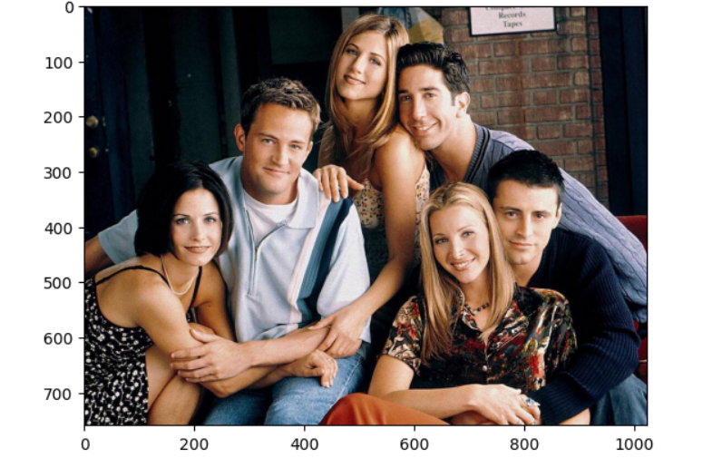

Slide 11
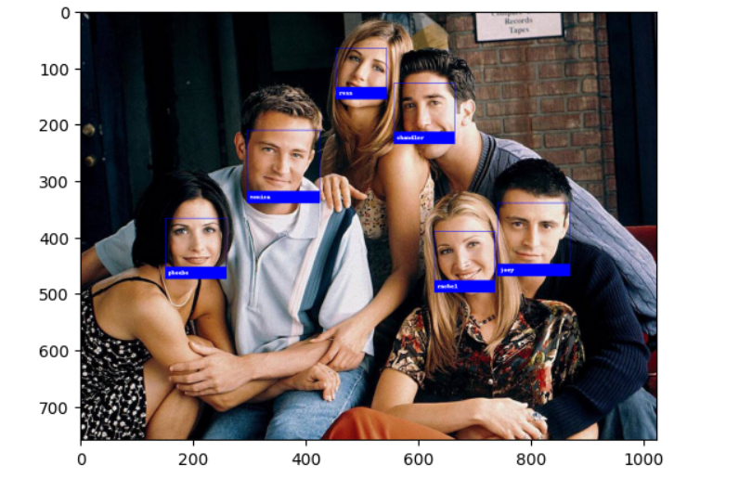

Slide 12
Future Enhancement
Design an intelligent system that can analyse objects.
Make them enable to see and feel like us.
Remove all its eliminations and eager to develop this software.
Enable them to suggest us to make them best use of objects.
Empower media and security services.

Slide 13
Conclusion
Face recognition technology has come a long way in the last twenty years. Today, machines are able to automatically verify identity information for secure transactions, for surveillance and security tasks, and for access control to buildings etc. These applications usually work in controlled environments and recognition algorithms can take advantage of the environmental constraints to obtain high recognition accuracy. However, next generation face recognition systems are going to have widespread application in smart environments -- where computers and machines are more like helpful assistants.

Slide 14

THANK YOU…

